Slide 1
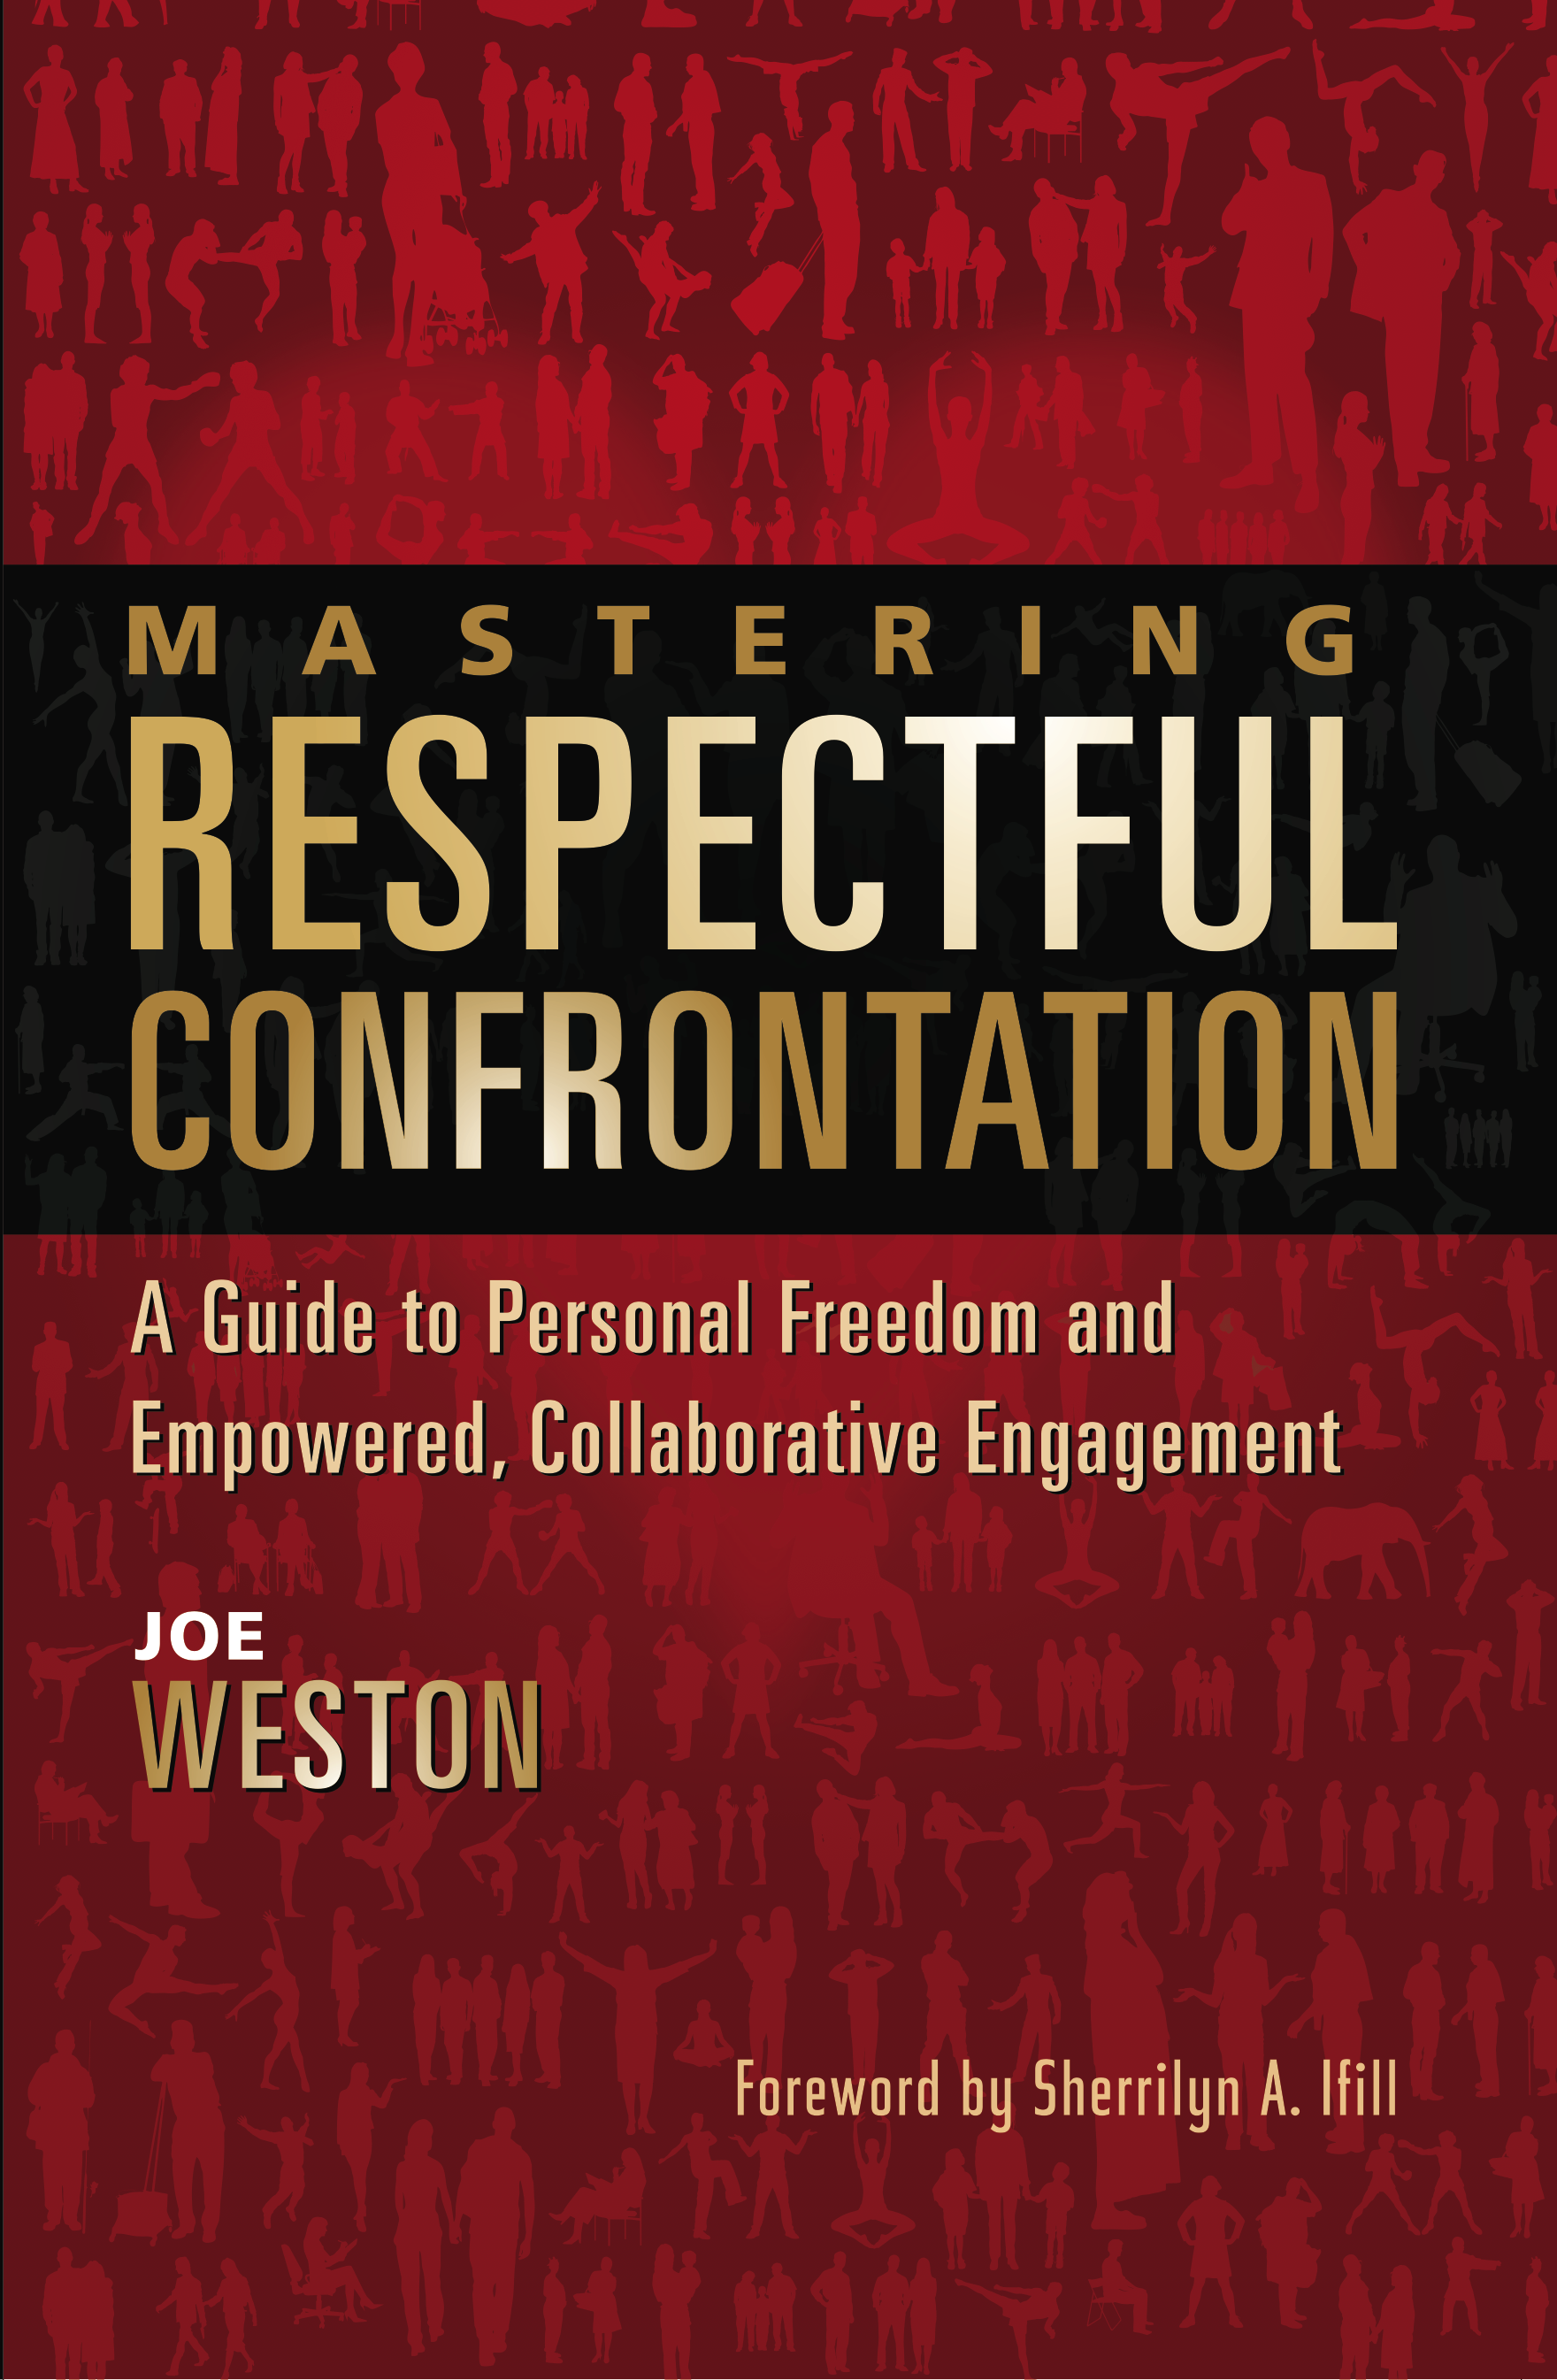

Slide 2
Goals
Learn about empowered, collaborative engagement.
Reframe views on confrontation, assertiveness, and true power.
Achieve greater self-confidence, personal freedom, fulfillment, and peaceful interactions with others.

Slide 3

Welcome

Slide 4
My truth ≠ The truth

Slide 5
“We will never end world war and strife until each one of us look at our own personal, psychological violence and take steps to eliminate it.”
Peace Pilgrim

Slide 6
Power and Leadership in the
21st century

Slide 7
“Human beings have discretionary energy, and they would give it to you if you treat them with dignity and respect.”
-Paul O’Neill, former Treasury Secretary of US under George W. Bush

Slide 8
When one moves into their vulnerability,
then their true power is revealed.

Slide 9
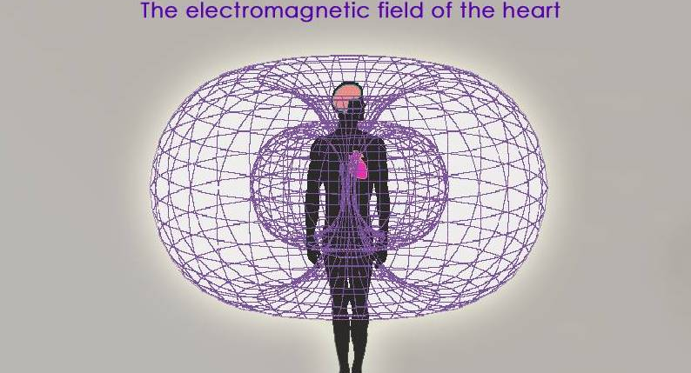

Slide 10
Respectful Confrontation
The practice of developing the respectful self
The practice of respectful engagement
The practice of respectful offense
The practice of respectful defense

Slide 11
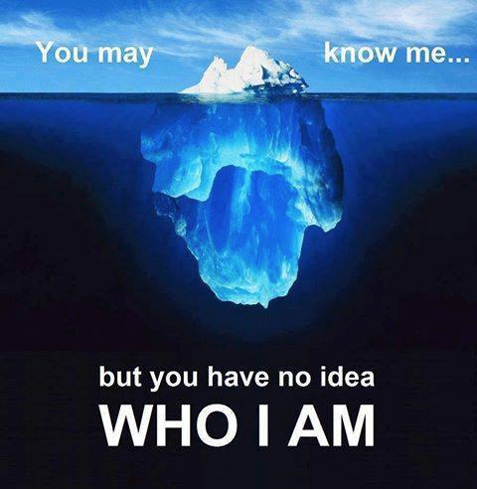

Slide 12
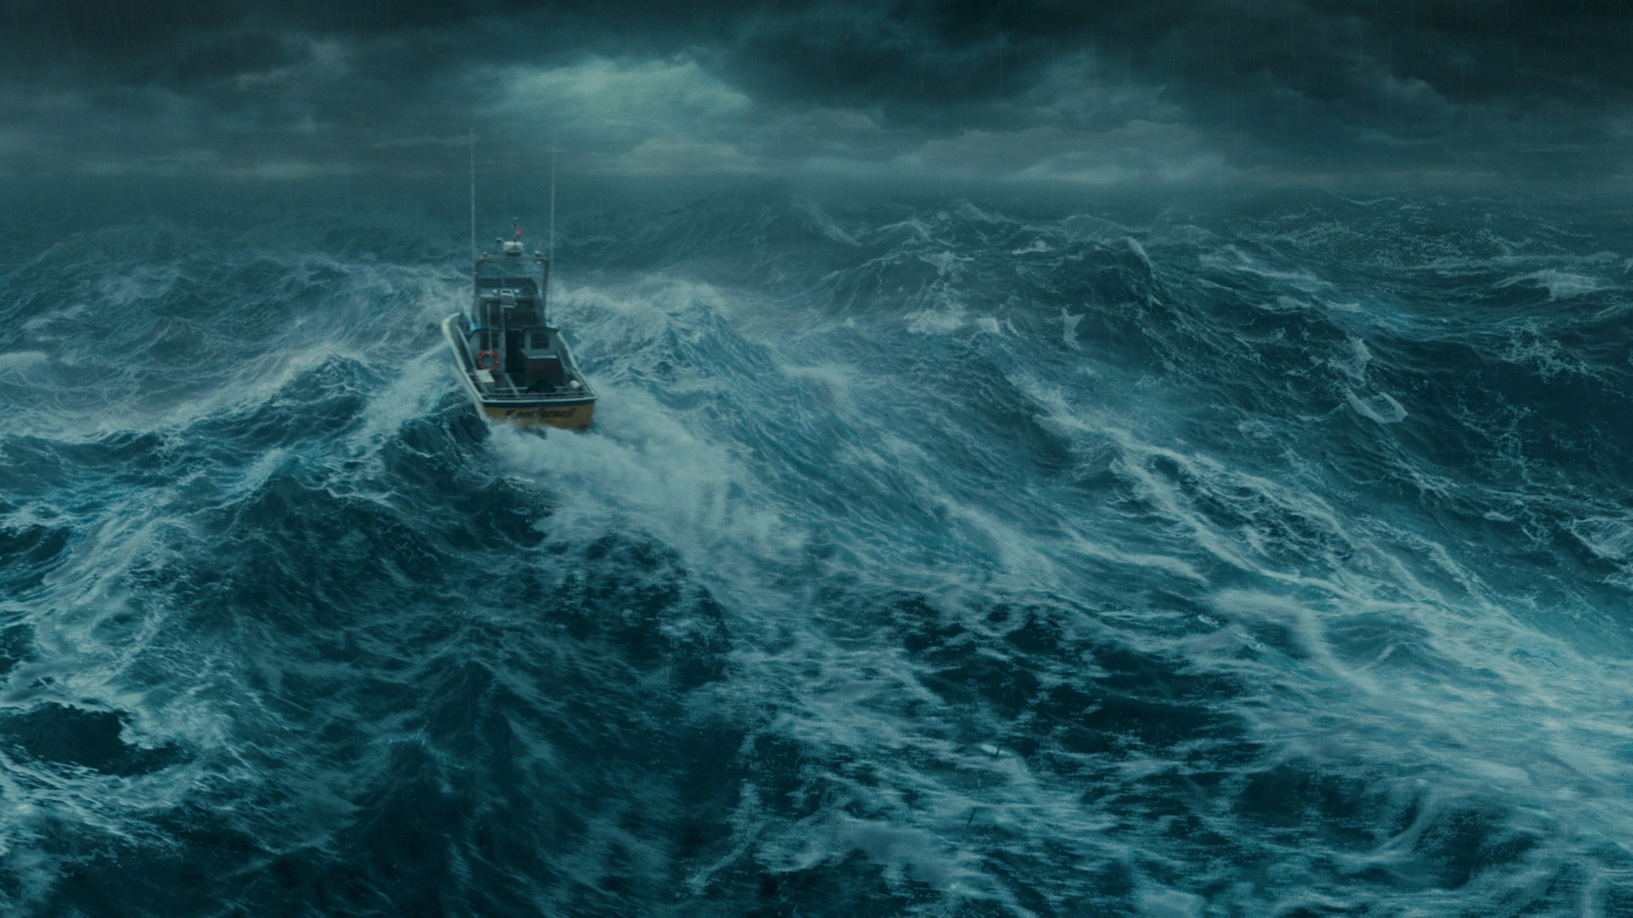

Slide 13


Slide 14
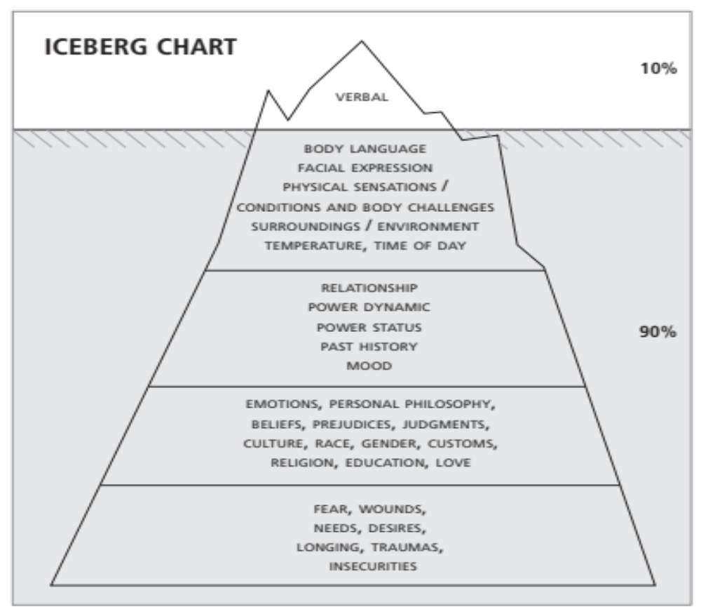

Slide 15
True power = Brute force
Confrontation = Conflict
Assertiveness = Aggression

Slide 16
3 F’s
Fight
Flight
Freeze

Slide 17
Brute force ≠ True power

Slide 18
4 Pillars of True Power
Grounding
Focus
Strength
Flexibility

Slide 19
Conflict ≠ Confrontation

Slide 20
Conflict
Pronunciation: 'kän-"flikt Function: noun Etymology: Middle English, to strike together, from com- + fligere to strike -- more at PROFLIGATE 1 : FIGHT, BATTLE, WAR 2 a : competitive or opposing action of incompatibles : antagonistic state or action (as of divergent ideas, interests, or persons) b : mental struggle resulting from incompatible or opposing needs, drives, wishes, or external or internal demands; see DISCORD

Slide 21
Confront
con·front Pronunciation: k&n-'fr&nt Function: transitive verb Etymology: from Latin com- + front-, frons forehead, front 1 : to face especially in challenge : OPPOSE 2 a : to cause to meet : bring face-to-face <confront a reader with statistics> b : to meet face-to-face : ENCOUNTER

Slide 22
Respectful Confrontation Definition
CONFLICT: an encounter that leads to the further separation of individuals, the breakdown of relationship, and the disempowerment of the other.

Slide 23
Respectful Confrontation Definition
CONFRONTATION: an encounter that leads to individuals coming closer together, deepening of relationship, and the empowerment of all involved.

Slide 24
“If you fear making anyone mad, then you ultimately probe for the lowest common denominator of human achievement.”
- Former US President, Jimmy Carter

Slide 25
Aggression ≠ Assertiveness

Slide 26
Assertive
Pronunciation:\ə-ˈsər-tiv, a-\ Function:adjective, Date: circa 1619
1 : disposed to or characterized by bold or confident assertion <an assertive leader>
2 : having a strong or distinctive flavor or aroma <assertive wines>

Slide 27
Aggressive
ag·gres·sive
Pronunciation:\ə-ˈgre-siv\ Function: Adjective, Date:1824
1 a: tending toward or exhibiting aggression <aggressive behavior> b: marked by combative readiness <an aggressive fighter>
2 a: marked by obtrusive energy b: marked by driving forceful energy or initiative : enterprising <an aggressive salesman>
3: strong or emphatic in effect or intent <aggressive colors> <aggressive flavors>
4: growing, developing, or spreading rapidly <aggressive bone tumors>

Slide 28
Respectful Confrontation Definition
AGGRESSION: any behavior, action, remark, gesture, or facial expression that impacts another with the goal to disempower and/or is received by the other in a harmful, threatening way.

Slide 29
Respectful Confrontation Definition
ASSERTIVENESS: any behavior, action, remark, gesture, or facial expression that impacts another with the goal to empower and/or is received by the other in a positive way.

Slide 30
“Courage is what it takes to stand up and speak. Courage is what it takes to sit down and listen.”
- Winston Churchill

Slide 31
“With realization of one’s potential, and self-confidence in one’s ability, one can build a better world.”
- His Holiness the Dalai Lama

Slide 33
http://www.respectfulconfrontation.com/

Slide 34
“We have to face the fact that either all of us are going to die together or we are going to learn to live together, and if we are to live together we have to talk.”
Eleanor Roosevelt

Slide 35
“Non-violence, which is the quality of the heart, cannot come by an appeal to the brain.”
Mahatma Gandhi

Slide 36
“Sweet are the uses of adversity which, like the toad, ugly and venomous, wears yet a precious jewel in his head.”
William Shakespeare

